Slide 1
IMPROVING THE SECURITY OF SOFTWARE
OWASP Foundation

Slide 2
MISSION
Open Web Application Security Project (OWASP) is a nonprofit foundation improving the security of software. Through community-led open source software projects, over 200 local chapters worldwide, tens of thousands of members, and leading educational and training conferences, the OWASP Foundation is the source for developers and technologists to secure the web.
Annually seven million technologists and developers visit owasp.org

Slide 3
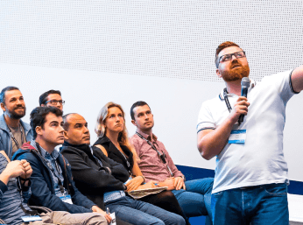
The OWASP Community
OWASP is a worldwide free and open community focused on improving the security of application software.
Our mission is to make application security visible so that people and organisations can make informed decisions about application security risks.
Session at Global AppSec Amsterdam

Slide 4

Its all for free
Everyone is free to participate in OWASP and all of our materials are available under a free and open software license.
All OWASP events (except conferences) are free to attend by both members and non-members of OWASP - and can be attended by anyone who is interested in Application Security and Cyber Security in general.
Member Lounge at OWASP Conference

Slide 5
The OWASP Foundation
We are a Global not-for-profit charitable organisation
Vendor-Neutral Community
Collective Wisdom of the Best Minds in Application Security Worldwide
Provide free tools, guidance, documentation
Meetings are free to attend (free drinks & food included)
Meetings are usually 2-hour seminars (usually 2 main talks, with optional lightning talks)

Slide 6
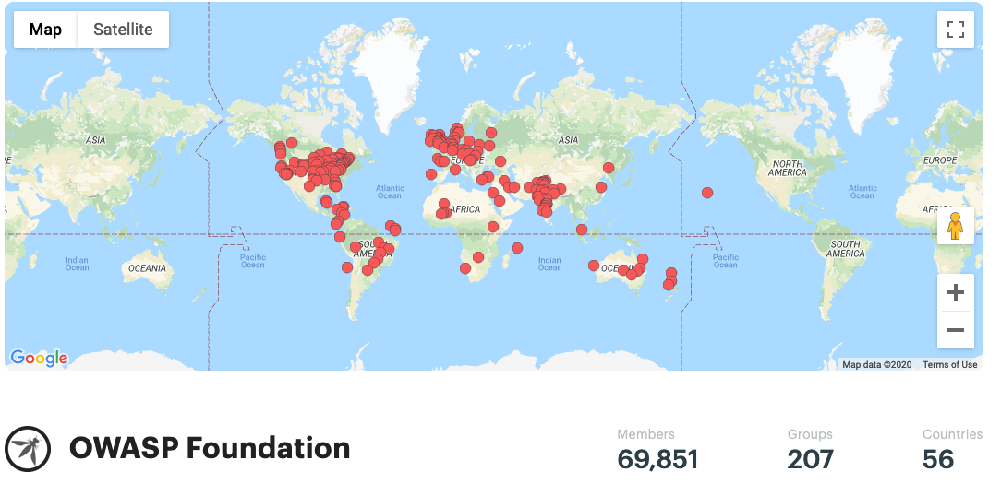
World Wide
207 local Chapters in 56 countries… and counting!

Slide 7
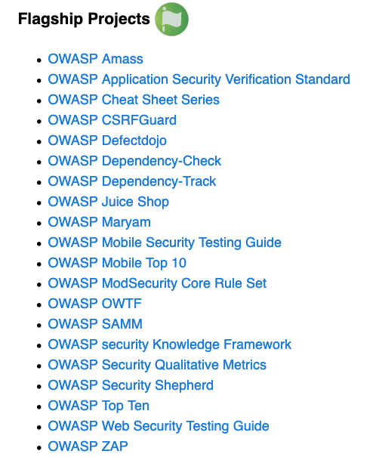
OWASP Projects
189 Projects including 20 Flagship Projects

Slide 8
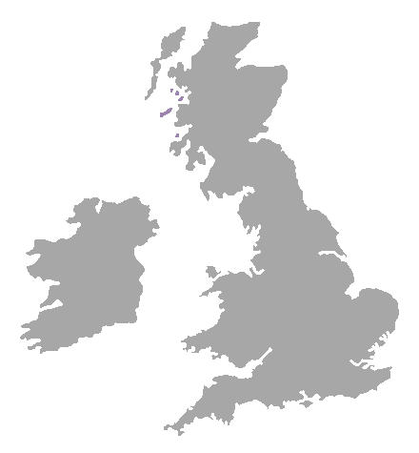
UK Chapters
Belfast
Birmingham
Bristol
Cambridge
Dorset
London
Manchester
Newcastle
Royal Holloway (inactive)
Scotland
Sheffield
Suffolk

Slide 9

We are all VOLUNTEERS!
45,000+ OWASP volunteers worldwide

Slide 10
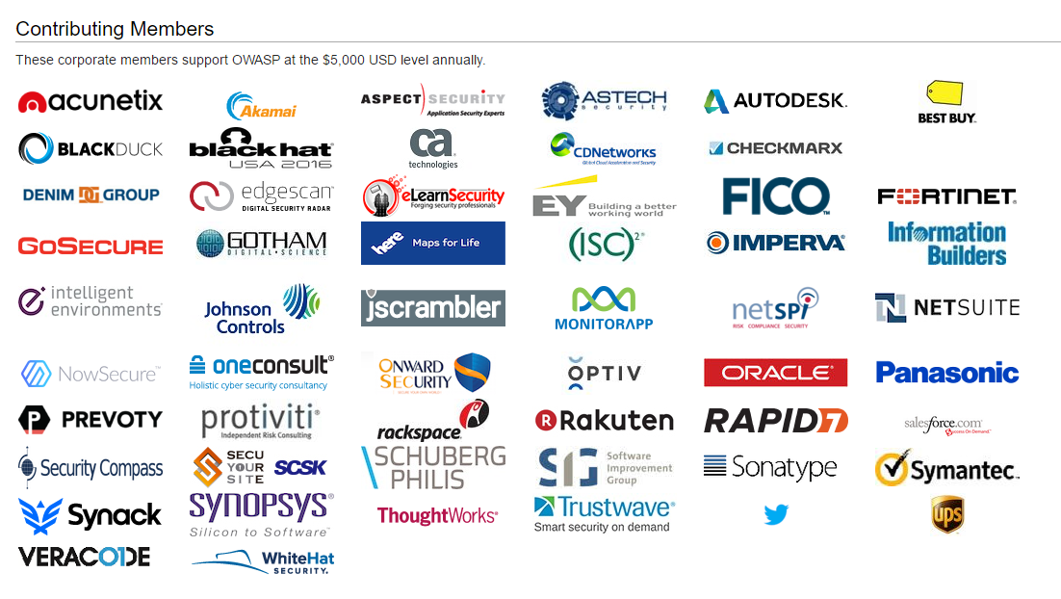

Slide 11






Premier members (donate $20,000/year):
New Corporate Members

Slide 12
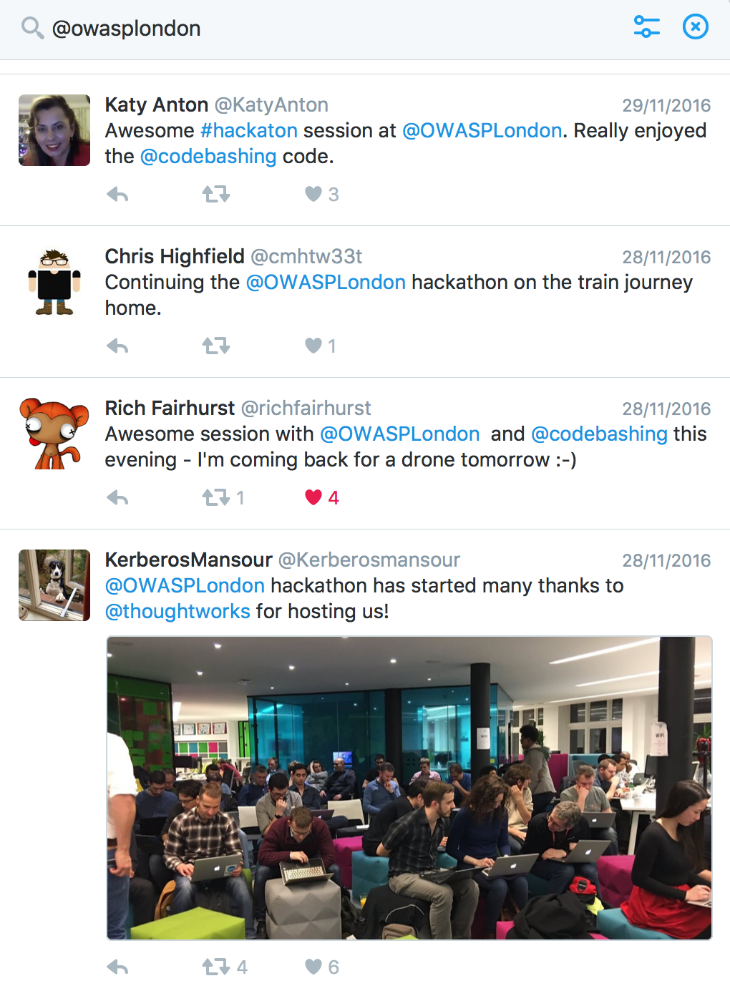
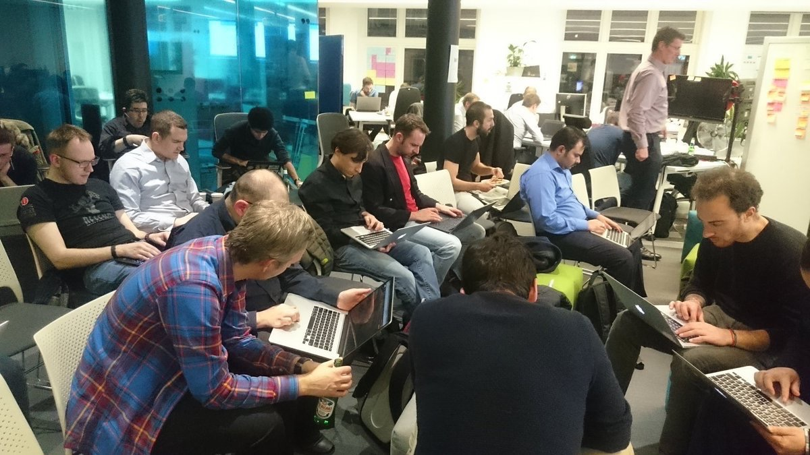
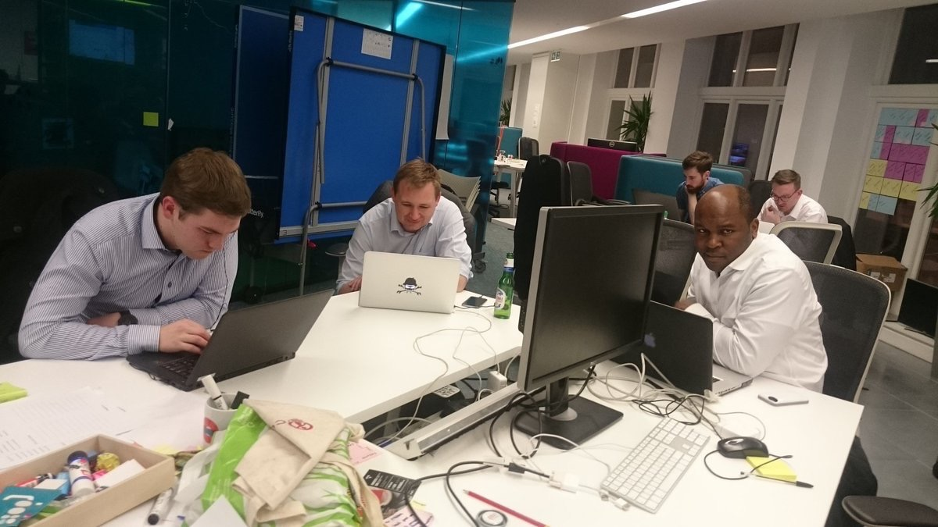

Slide 13
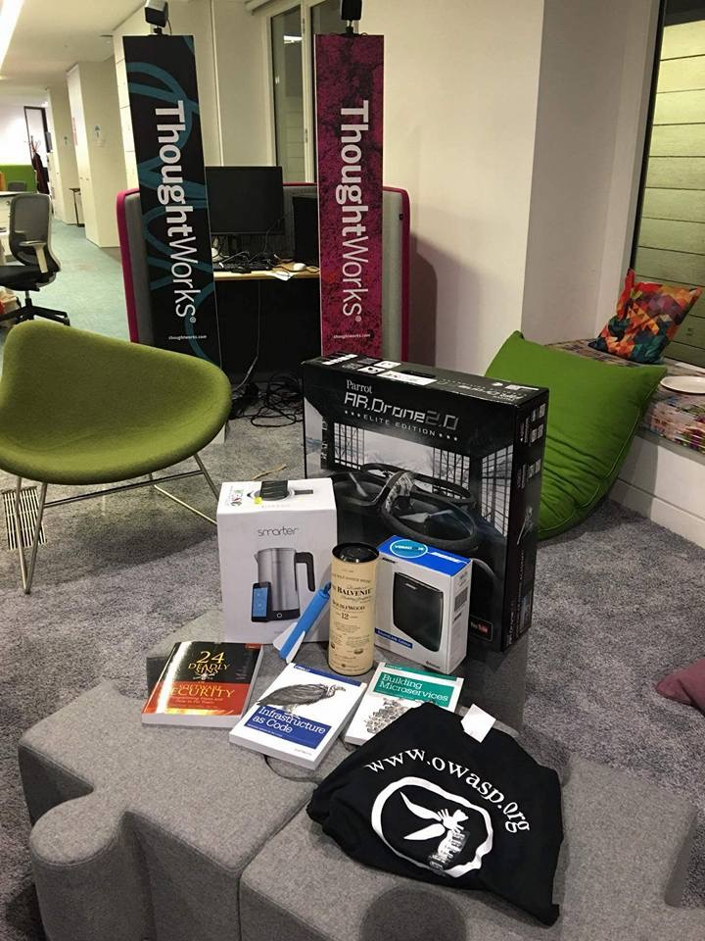
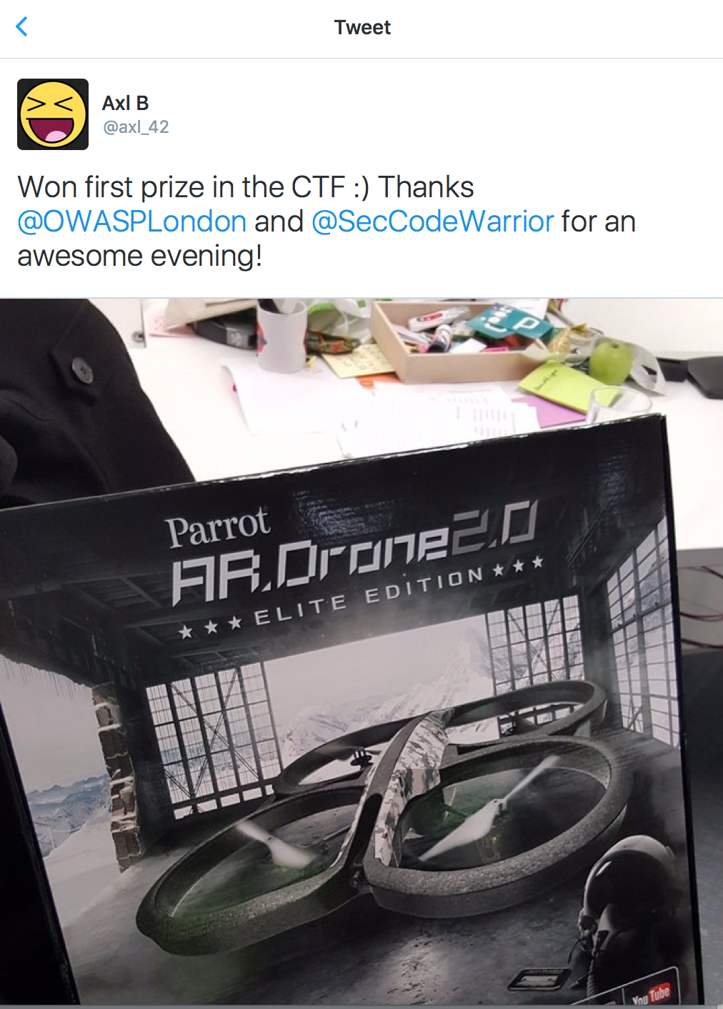
CTF Prizes

Slide 14

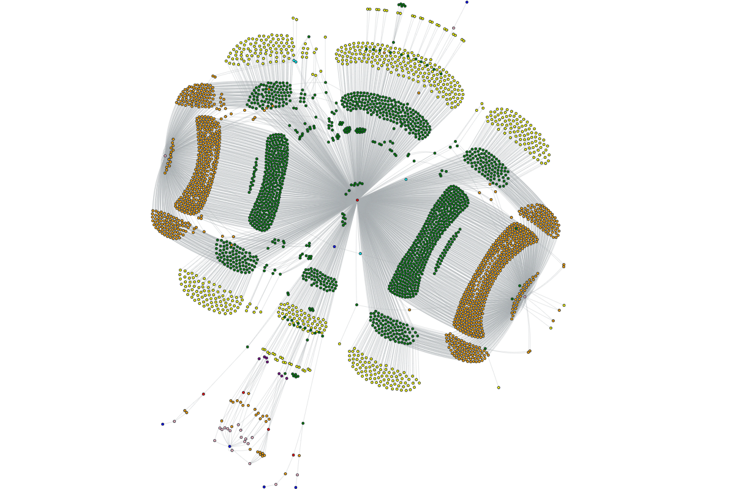
OWASP Amass
Flagship Project
Performs network mapping of attack surfaces
Part of Kali Linux
Used by Bug Bounty Hunters
Stores Findgings in a GraphDB

Slide 15
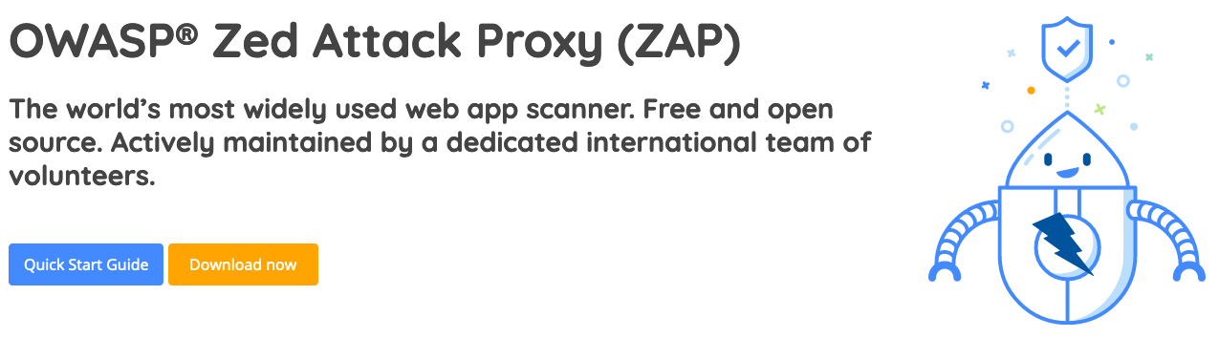
OWASP ZAP
Flagship Project
Web App DAST tool
Integrates into CI/CD Pipeline
GitHub Actions and GitLab Modules exist
140+ Contributors

Slide 16
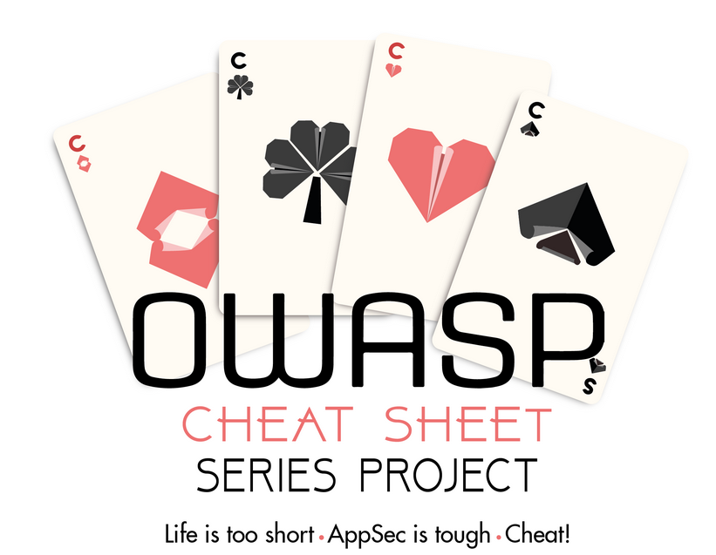
OWASP Cheat Sheet
Flagship Project
Helps Devs with AppSec Issues
Project is lead by industry veterans
130+ Contributors

Slide 17
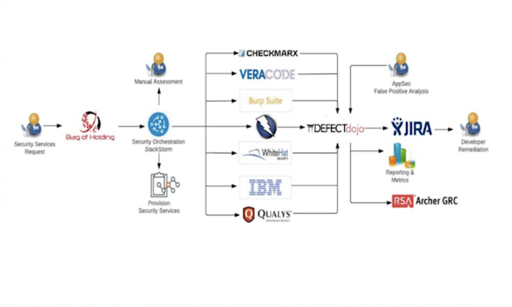
OWASP Defect Dojo
Flagship Project
Consolidated Security Findings
Over 60 tool Integrations
De-dupes findings
Connects to Jira for bug reporting

Slide 18
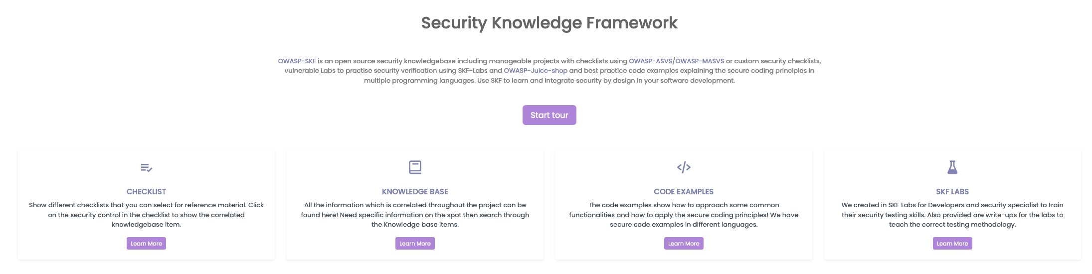
Security Knowledge Framework
Flagship Project
Helps Devs with AppSec Training
Part of the OpenSSF
An Open Source SaaS version is being developed
https://beta.securityknowledgeframework.org/dashboard

Slide 19
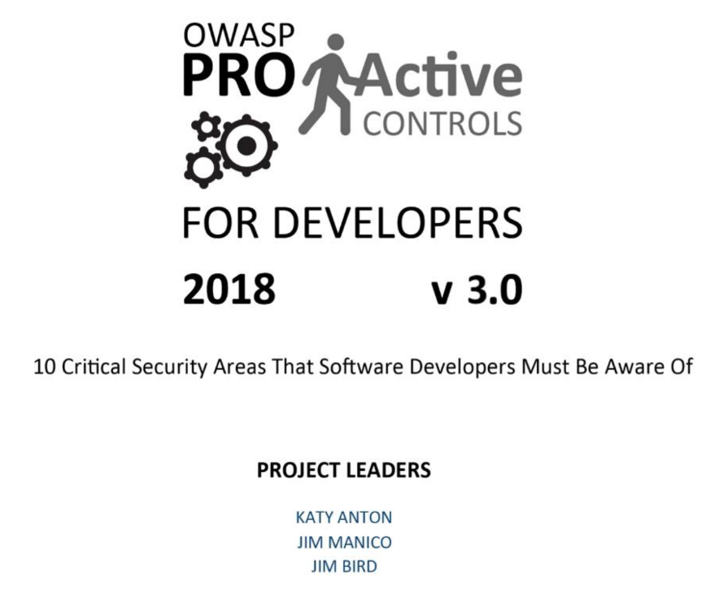
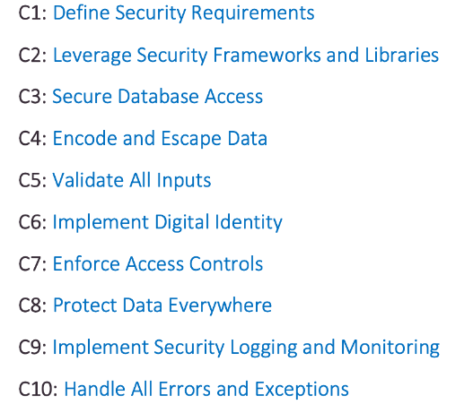
OWASP Top Ten Proactive Controls

Slide 20





Keep In Touch
Join an OWASP Mailing List:
https://groups.google.com/a/owasp.com
Follow us on Twitter
@OWASP
“Like” us on Facebook www.facebook.com/groups/owaspfoundation
Slack: owasp.slack.com #owasp-community
Watch us on YouTube: YouTube.com/OWASPGLOBAL
www.meetup.com/pro/OWASP
Visit the OWASP website
https://owasp.org

